Slide 1
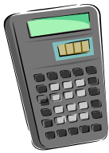

Scientific Notation
True or False?
24 000 000 is written as 2.4×10⁷
1 000 000 000 is written as 1×10⁹
35 000 is written as 35 ×10³
17 is written as 1.7 ×10¹
6 can be written as 6 ×10⁰
38 000 is written as 3.8 ×10⁴
7 500 000 is written as 75 ×10⁵
0 = 10⁰
1 ×10⁴ is equal to one thousand
1 ×10⁶ is equal to one million
T
T
F
T
T
T
F
F
F
T

Slide 2
As we saw yesterday, we can use Scientific notation on very large numbers.
230000 | = | 2.3 x 100000 | = | 2.3 x 10x10x10x10x10 | = | 2.3 x 10⁵
23000 | = | 2.3 x 10000 | = | 2.3 x 10x10x10x10 | = | 2.3 x 10⁴
2300 | = | 2.3 x 1000 | = | 2.3 x 10x10x10 | = | 2.3 x 10³
230 | = | 2.3 x 100 | = | 2.3 x 10x10 | = | 2.3 x 10²
23 | = | 2.3 x 10 | = | 2.3 x 10 | = | 2.3 x 10
But what about small numbers?
  Plancks’Constant (Quantum Physics)
  0.000000000000000000000000000000000662606896 Js

Slide 3
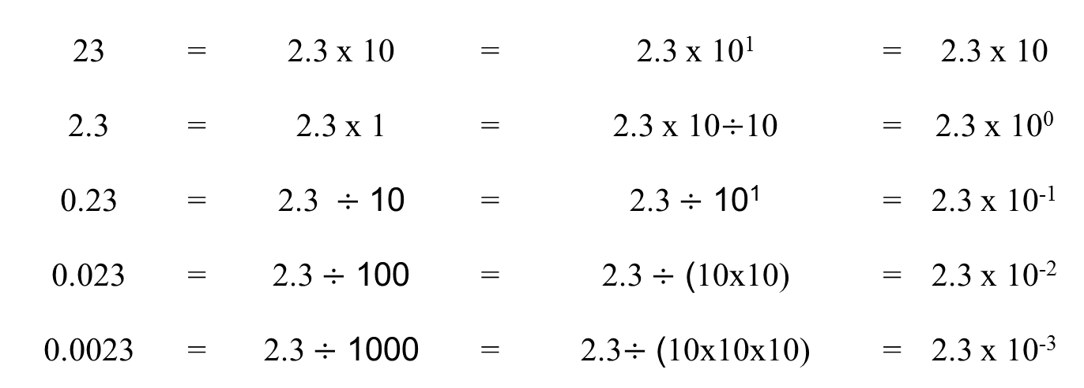
We can follow the same idea..
  Plancks’Constant (Quantum Physics)
  0.000000000000000000000000000000000662606896 Js
= 6.62606896 x 10⁻²⁴ Js
scaleofuniverse
Notes:
Click on link to explore sci notation and lengths or show video “smallest to biggest” on connect.

Slide 4
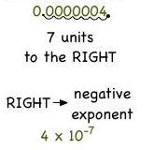
24
7
30
Topic : Scientific Notation
Date
EQ : How do we use Scientific Notation to show small numbers?
Count how many places we shift the decimal place to the right to get the decimal point just past the first non zero number.
Make that number a negative number and it becomes the index number we use.
To go from Scientific Notation back to ordinary numbers, shift the decimal point left the same number of places as the indice’s value.

Slide 5
24
7
30
Topic : Scientific Notation
EQ : How do we use Scientific Notation to show small numbers?
To compare Scientific Numbers.
1.Check they are in the correct form (only 1 number in front of the decimal place)
2. Anything with a larger index number is the larger number.
3. If the index numbers are the same – just choose the larger number.
Eg.
1.2 x 10⁴ > 4.5 x 10²
4.5 x 10⁻¹⁹ < 3.6 x 10⁻⁵
8.7 x 10³ > 8.7 x 10⁻³
2.4 x 10³ < 3.2 x 10³

Slide 6
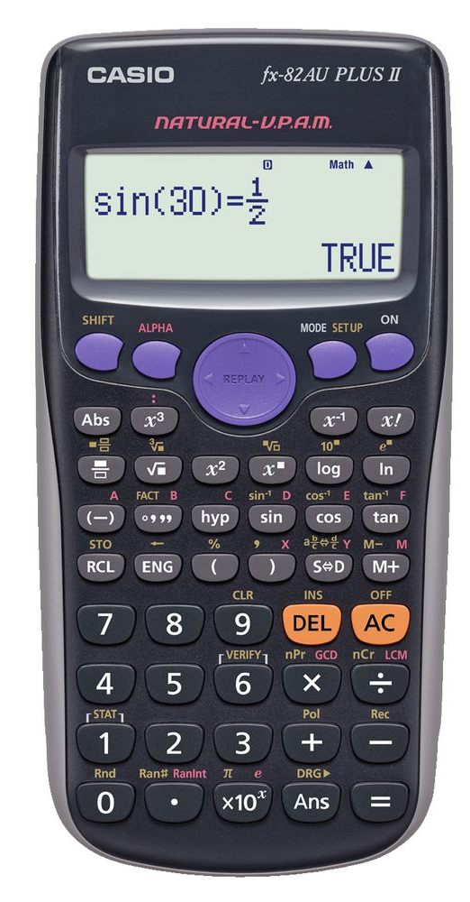
Using the calculator.
3.4 3 = 3400
x10^{x}
7.4 -4 = 0.00034
x10^{x}

Slide 7
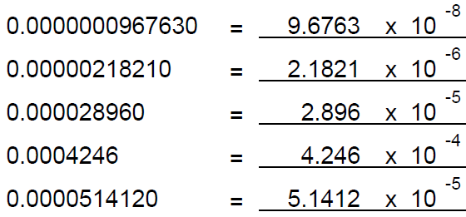
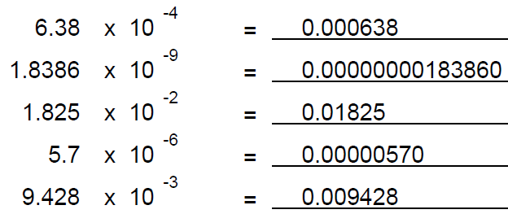
Let’s try a few..

Slide 8
Now it’s time to…
1. Complete the worksheet
2. Complete your summary

